Slide 1
Evergreen Teen Book Award
2015-2016 Nominees

Slide 2
The Nazi Hunters: How a Team of Spies and Survivors Captured the World’s Most Notorious Nazi by Neil Bascomb
During World War II, Adolf Eichmann was the man Hitler put in charge of the destruction of the Jewish population of Europe. Eichmann carried out his orders with nightmarish effectiveness, directing the terrible process of removing Jewish people to the Nazi death camps. At the defeat of Germany, Eichmann managed to slip through the Allies hands and escape prosecution, disappearing into history. Years later in Argentina, a young woman, Sylvia Hermann, meets a young man named Nick. She brings him to dinner to meet her family but Nick does not impress. He boasts about his father having been highly placed in the Nazi regime, not knowing that Sylvia’s father left Germany to escape the Nazis. Sylvia stops dating Nick, but she and her father wonder, Nick’s last name is Eichmann… could his highly-placed father be Adolf Eichmann? This begins the true story of how one of the most notorious Nazis was brought to justice after years on the run. The Nazi Hunters tells how the initial amateur investigations of the Hermanns eventually led to the assembly of a team of Israeli spies—many of them Holocaust survivors themselves—and Eichmann’s capture in Argentina.
The Nazi Hunters is non-fiction but the book reads like a suspenseful thriller. Author Neal Bascomb keeps his readers engaged with descriptions of safe houses, disguises and stakeouts but never lets them forget the importance of bringing Eichmann to justice for his role in the deaths of millions of people during World War II.

Slide 3
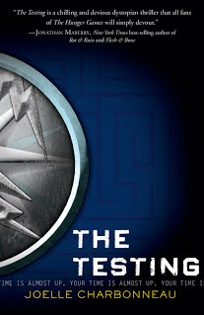
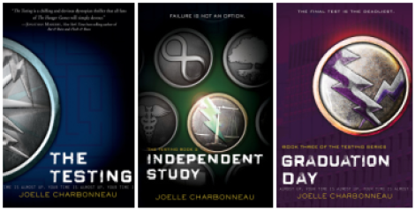
Cia Vale graduates from high school and believes that her life as an adult in the Five Lakes Colony is beginning as just an average member of the community; a community that is recovering from a war that left it a charred wasteland. When quite unexpectedly a representative from the Commonwealth comes to take her and 3 others to Tosu City to be tested for the opportunity to attend the university and become world leaders. On the eve of her departure her father gives her advice to do her very best, do what has to be done, but trust no one.
The group of students are brought together to take academic tests, physical challenges and compete with each other to be the best survivors in the eyes of the Testing officials. The final test requires making decisions that will haunt them forever. Cia knows things are not as they seem and from the talks with her father knows that not all the testing is as described. There are cameras watching every move and possibly more.
Cia begins the Testing with a childhood friend, Tomas, together they progress through the Testing enduring great challenges, and personal pain, meanwhile forging an alliance that becomes much more. The ending will make you think twice about the decisions of those in charge and what they really want.

Slide 4
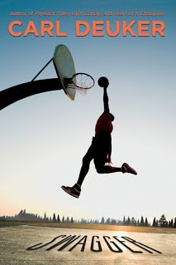
Jonas is a high-school senior when his family must relocate for his father’s job. This has the potential to ruin Jonas’ dreams of playing small-college basketball, as he must adjust to a new coach, fit onto a new team, and earn his playing time all over again. Luckily, his new neighbor and friend Levi is a very good player, if a bit odd, quiet and religious.
His new head coach is the dictionary definition of Old School, which clashes with Jonas’ preferred style of play, although the select coach of his summer team gets him.
When Levi, normally enthusiastic to ball, begins to change his behavior and avoid the court, Jonas knows something is up, but perhaps, his own scholarship hangs in the balance, depending on his actions.
If you want athletic drama, well-drawn descriptions of court action, realistic scenes of athletes working to excel on the court, Carl Deuker has thrown down a winner. Next man up!

Slide 5
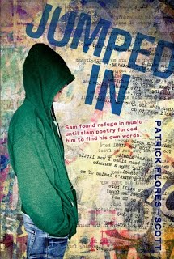
Sam used to have things to say back in Aberdeen, when he lived with his mom, when he had dreams of starting a rock band with his two best friends. That was then. Now that his “temporary” stay with his grandparents in Des Moines has turned into years, Sam spends most of his days tucked away in his hoodie thinking about all the ways he can remain invisible.
Until one day when he becomes visible. When Luis enters his English class, Ms. Cassidy notices a vacant desk and an empty chair that happens to be right next to Sam. All of a sudden he has two people not only looking at him, but seeing him. And, when Luis asks Sam to be his partner in a class poetry slam, Sam is quite surprised when he says, “okay.” But, maybe Sam has finally found some words he wants heard.
Listen to what Sam’s got to say in Jumped In by Patrick Flores-Scott.

Slide 6
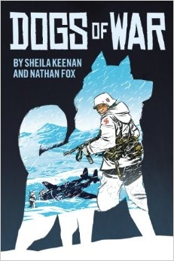
We usually think of soldiers as human, but that's not always true - there are famous canine warriors for almost every war in history. They sniffed out bombs, ran messages across dangerous battlefields, and served as sentries, mascots, and search-and-rescue teams. Dogs of War tells just a few of their stories. Three action-packed tales, all based on real events, tell three stories about dogs who saved the lives of their human companions.
In the first story, a sixteen-year old soldier and his dog Boots face brutal trench warfare during WWI. When they're separated from their unit, the boy and the dog have to fend for themselves in the middle of a war zone. In the second, a sled dog named Loki and a American are chased across the tundra by Nazis. In the final story, a veteran remembers Sheba, the service dog who kept him alive in the jungles of the Vietnam War.
With art straight out of a comic book, these stories about friendships, bravery, and the cost of war for soldiers both human and animal.

Slide 7
Eleanor is a large girl with red hair and “wrong” clothes. People at school pick on and bully Eleanor and she doesn’t fight back. She is one of five children in a poor family and has a drunk and abusive stepfather. Park is a nice looking, half Korean boy who has lots of friends, but still doesn’t feel like he fits in. He likes comic books, music and wearing eyeliner. He has very supportive parents who don’t really understand him, yet accept who he is. This unlikely pair of teens is forced together when Eleanor has to “sit down” in the seat next to Park on the school bus. Each day, the two fifteen-year-olds begin noticing each other more and finding that they have things in common. During their encounters on the school bus, the reader is drawn into the budding romance of Eleanor and Park.
Set in 1985 in Omaha, Eleanor and Park is both heartwarming and heartbreaking. The book is told in alternating voices and reveals the good and bad parts of human nature.

Slide 8
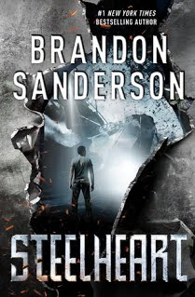
Twelve years ago Calamity appeared in the sky. Before that everything was normal. After Calamity, the world knew the destruction of Epics, ordinary people were given super powers. In a cruel twist of fate all Epics seem to be using those powers for evil. They quickly divide up the world and rule their domains with little mercy. One of the most powerful Epics is known only as Steelheart, who can turn nearly everything to steel with a touch and bullets bounce right off him. Every Epic, even Steelheart, has a weakness that can kill them.
David believes he knows that weakness and seeks revenge. When David was eight he witnessed Steelheart and the Epic named DeathPoint fight for control of Chicago. David is the only living witness to that day- the day that Steelheart bled at the hand of David’s father and in retaliation Steelheart quickly kills David’s father and everyone else in the building. David manages to live to tell the tale by hiding in a bank vault as the rest of the building is turned to steel around him.
When the Reckoners, a group that hunts and kills Epics, comes to town, David is determined to join their group and finally have his revenge.
The Reckoners are not interested in new recruits but David will
stop at nothing to see Steelheart bleed once more. He will have
his revenge or die trying.
For youth who like supervillains and lots of action.

Slide 9
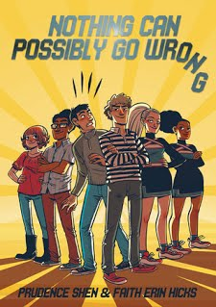
“Save the cheerleader, save the world”. This was a popular mantra in the TV show Heroes, and also a plotline that rings true for “Nothing Can Possibly Go Wrong” by Prudence Shen and Faith Erin Hicks. If you were a Glee fan and need a fix now that the show has ended, this story is for you! Nolan is coasting through high school as a jock and boyfriend of head cheerleader Holly, oh until she breaks up with him via text message. Then his friend Nate lets Nolan know that he and his ex-girlfriend Holly are officially at war when the school’s limited budget has to either go to the Robotics team so they can participate in a competition, or to the cheerleaders for new uniforms.
The competition gets more intense when both Holly and Nate decide to run for ASB president, which all comes to a screeching halt after they are both reprimanded for mud slinging campaign tactics. This leads to a very unlikely collaboration between the Robotics team and the Cheerleaders to figure out how to get what they both want, money for their causes.
Filled with well-timed comedic delivery and hilarious art work, this story will entertain and surprise you!

Slide 10
Willow has a good situation with her adoptive parents where she can garden, express herself, and chase her many passions. When she starts junior high at her new school, she hopes to fit in better, and perhaps find a friend. But, her genius and iffy social skills make it difficult with teachers and her fellow students alike.
When a tragedy befalls her family, she is again forced to try to make it in a new situation, with a Vietnamese nail salon owner as her surrogate mom, and an ineffectual counselor as her guidance.
However, Willow doesn’t do tragedy. She will find a way to make this new life situation work, even if there are a few bumps on the way. A touching book that might make you tear up, but one that will certainly have you rooting for Willow every step of the way.

Slide 11
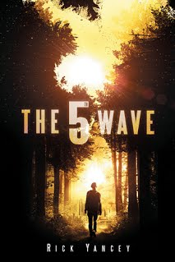
Forget about flying saucers, little green men, giant spider machines or cute little aliens trying to phone home. The real invasion came in waves. Cassie is a normal 16 year old high school girl -- friends and school and a massive crush on Ben Parish, the star football player who doesn't know she's alive. Then the power goes out (the 1st Wave), the oceans rise (the 2nd Wave), the plague strikes (the 3rd Wave). After losing her mom to the plague, her brother Sammy is taken away to God knows where and her father killed, Cassie learns that there are only two rules that matter - 1) Trust no one and 2) the only way to stay alive is to stay alone. She spends her days trying to avoid the Silencers (The 4th Wave) - the snipers picking off careless survivors, one by one - and trying to find her brother. What will the 5th Wave bring?
Then she meets Evan. He saved her life, or did he? Something about him just doesn't seem right. His story just doesn't ring true, and he seems to know way too much about her. Can she trust him to help her rescue her brother? Is Evan what he appears to be or could he be one of The Others? Meanwhile, children are being microchipped, given uniforms and guns and assigned to squads - a children's army sent out to kill the alien invaders.
Rick Yancey has written a story of a new America where children and teens are forced to grow up too fast. Where the only important possessions are an M16, a knife, food and water. Where everyone is suspect. Cassie, Evan, Ben, and the others must to make difficult choices in order to stay alive. At times violent, suspenseful, and even a bit of a romance, The 5th Wave is a story of strength, resilience, and, survival that will keep you guessing to the very end.

